Slide 1
Preliminary ROUNd
Quiz BY : Aman Parab

Slide 2
Some rules before we begin……..
20 questions and 5 starred questions.
20-30 seconds per question/slide depending on the length and difficulty :p .
Top 5 teams go through to the finals.
In case of a tie , team having greater number of starred questions correct will progress.
Cheating will result in immediate disqualification.

Slide 3
Q1) A word used in the united states if someone lose their job and gets outsourced to india , specifically to bangalore . What is that word ?

Slide 4
BANGALORED

Slide 5
Q2) “There were a lot of different colour iterations” , says ruth kedar , the graphic designer of the now famous logo . ”we ended up with the primary colours , but instead of having the pattern go in order , we put a secondary colour on the letter l , which brought back the idea that “X” doesn’t follow the rules”. ID “X”

Slide 6


Slide 7
Q3) What special input mode was added to the Gboard , for those who are not able to physically use the text input mode ?

Slide 8
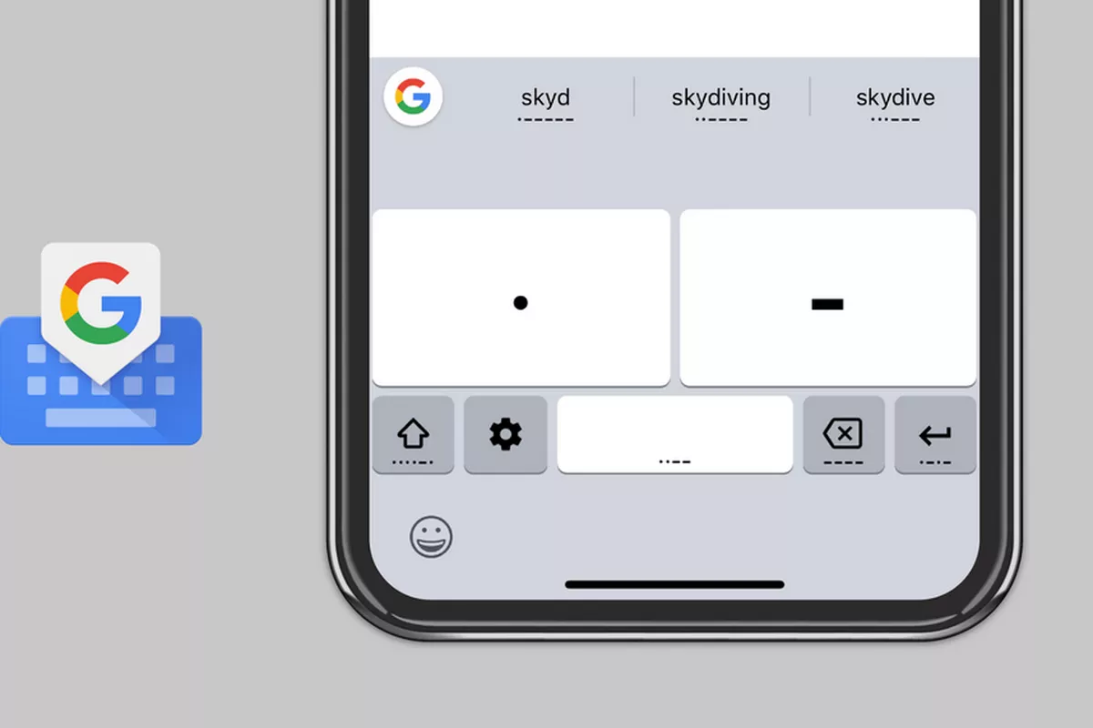
MORSE CODE

Slide 9
Q4) “Completely Automated Public Turing test to tell Computers and Humans Apart”. This may sound a bit complicated to you but we make use of this very frequently . What is this commonly called ?

Slide 10
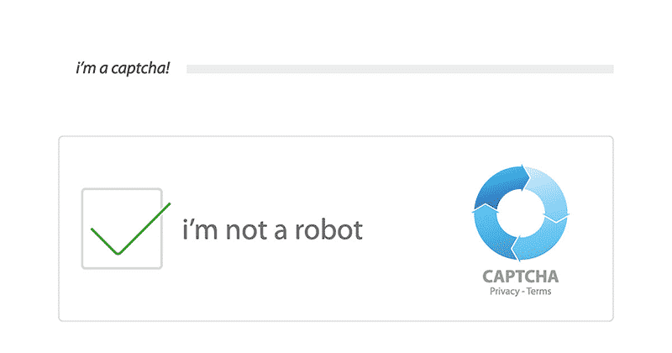
CAPTCHA

Slide 11
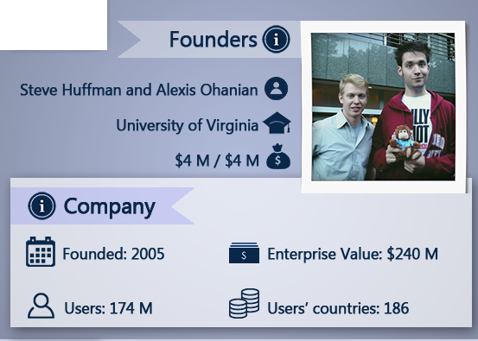
*Q5) NAME THE COMPANY THAT THESE GUYS STARTED.

Slide 12


Slide 13
Q6) Amit Jain’s “X” is a story of a small-town startup in India achieving big success. At his office reception in Jaipur, a touristy town in India, Amit has put up a wall-sized medieval world map showing the few empires that existed then. From Jaipur, Amit wants to conquer classifieds and automobile-related web services. After India, Amit has set his sight on Southeast Asia, where it is already active in countries such as Indonesia. ID “X”

Slide 14
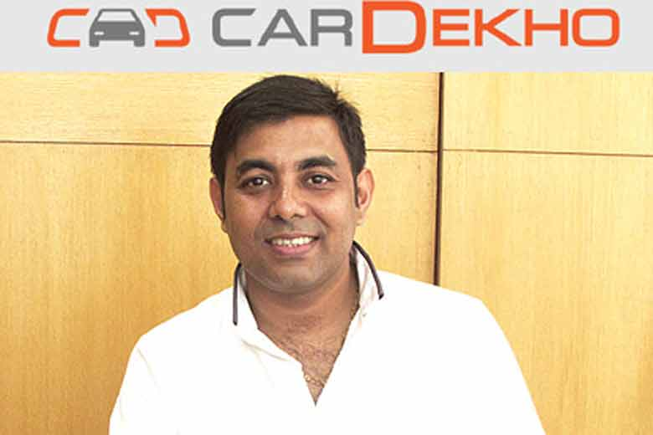

Slide 15
Q7) 1.0: Alpine
1.1: Little Bear
2.0: Big Bear
2.1: Sugarbowl
2.2: Timberline
3.0: Kirkwood
.
.
.
10.0: Whitetail
10.1: Butler
10.2: Corry
10.3: Erie
11.0: Tigris
WHAT ARE THESE ?

Slide 16
CODE NAMES GIVEN TO DIFFERENT IOS VERSIONS

Slide 17
*Q8) ‘The way it's meant to be played.’
THIS IS THE TAGLINE OF WHICH COMPANY ?

Slide 18


Slide 19
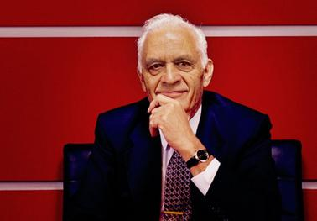
*Q9) WHO IS THIS ‘SOUND GENIUS’ WHO EXPIRED IN 2013 ?

Slide 20
AMAR GOPAL BOSE aka THE FOUNDER OF BOSE

Slide 21


Q10) Which car company is the PARENT COMPANY to the above given car companies ?

Slide 22


Slide 23
Q11) X may be an engrained company brand nowadays, but back in 1975, the company was just a gleam in Y and Z’s eyes.
The company was officially established in April 1975, with the name coming from a combination of “microprocessor” and “software” – which is fitting given that they were creating software for the Micro Instrumentation and Telemetry Systems’s (MITS) Altair 8800.
ID X Y and Z

Slide 24
X : Microsoft
Y : Bill Gates
Z : Paul Allen

Slide 25
Q12) _______is a live streaming video platform owned by _______ Interactive, a subsidiary of Amazon . Introduced in June 2011 as a spin-off of the general-interest streaming platform, Justin.tv, the site primarily focuses on video game live streaming, including broadcasts of eSports competitions, in addition to creative content, "in real life" streams, and more recently, music broadcasts. Content on the site can either be viewed live or via video on demand . Most popular streamers on this platform include NINJA , SHROUD , POKIMANE .
BLANKS ARE INDICATIVE AND BOTH BLANKS ARE THE SAME.

Slide 26


Slide 27
Q13) “Today, the taxi business does not realise its full potential. The requirement of taxis will increase two to three times. People will even stop using their cars as taxis would be easily available. The taxis will charge government approved rates “, said Goa Chief Minister Manohar Parrikar at the launch of the app.
WHAT IS THE NAME OF THE APP BEING TALKED HERE ?

Slide 28


Slide 29
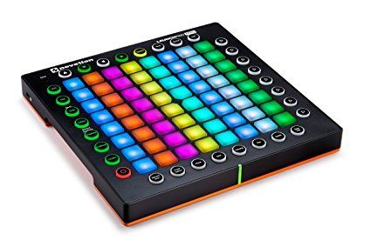
Q14) Manufactured by a company named Novotation , name this electronic instrument which has gained a lot of popularity in the recent years and is being used by many electronic artists , youtubers etc .

Slide 30
LAUNCHPAD

Slide 31
*Q15) IF BLACKBERRY = RESEARCH IN MOTION
EBAY = AUCTIONWEB
THEN WHAT IS GOOGLE = ?

Slide 32
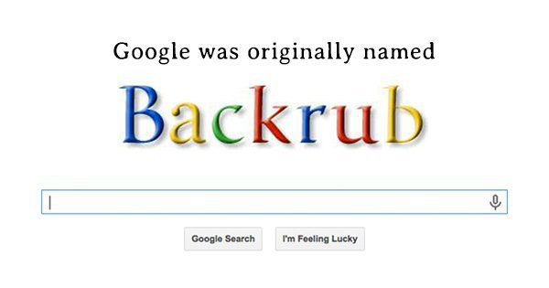
BACKRUB

Slide 33

Q16) ID the logo

Slide 34


Slide 35

*Q17) WHO OWNS THIS COMPANY ?

Slide 36
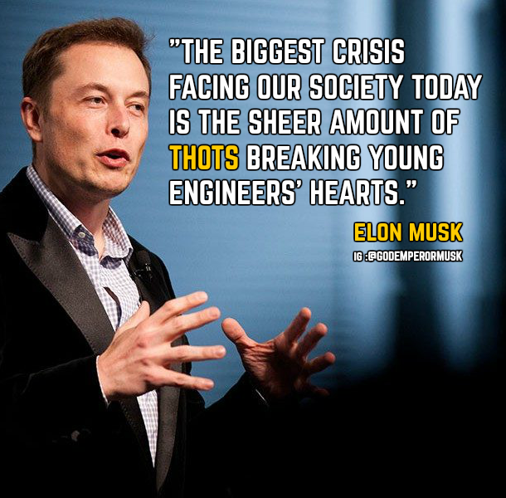

Slide 37

Q18) ID the logo

Slide 38


Slide 39
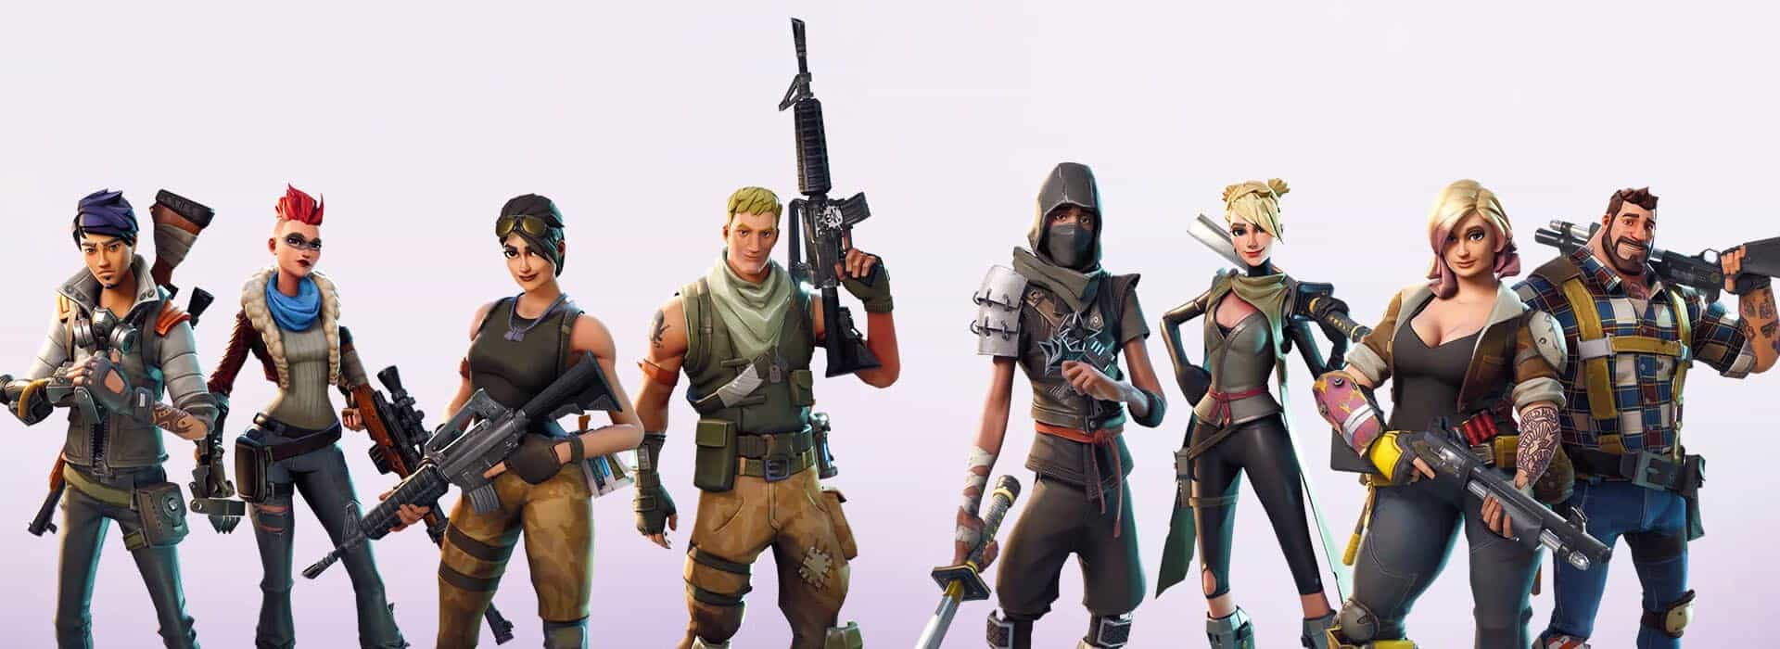
Q20) ID these characters form a very famous video game.

Slide 40
Q19) ID the logo

Slide 41

DROPBOX

Slide 42
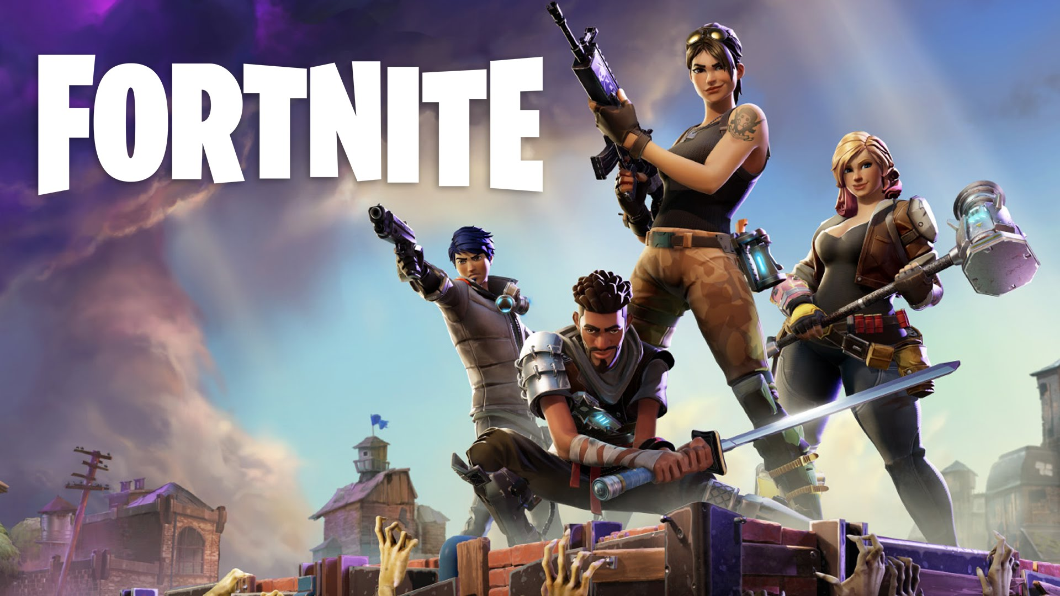

Slide 43
THE END

